Slide 1



Team Dynamics
The Decline of Birth Rates in South Korea
Javlonbek 12194926
Shokirjon 12194867
Jakhongir 12210220

Slide 2


Overview
Introduction
01
Discussion
02
Population Forecasting and implementation
03
Survey
04
Data analysis
05
Policy Recommendations
06

Slide 3

Introduction
This topic is important as it has impact on South Korean economy.
Because it may cause labor shortages, economic unstability.
Our team tryies to raise public awareness such as educating Society and Community Engagement.

Slide 4



Discussion
Although the Korean government has constantly increased the budget for solving the low fertility issue, the fertility rate has gradually decreased.
Accordingly, it stated that the life courses of both men and women were transformed into labor-based life courses. People in their 20s and 30s witnessed the rapid dissolution of norms associated with marriage or the gender role in their families.

Slide 5
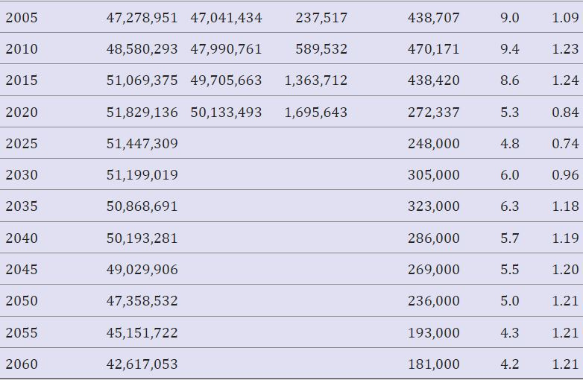
Population Forecast
Total population
Koreans
Foreigners

Slide 6
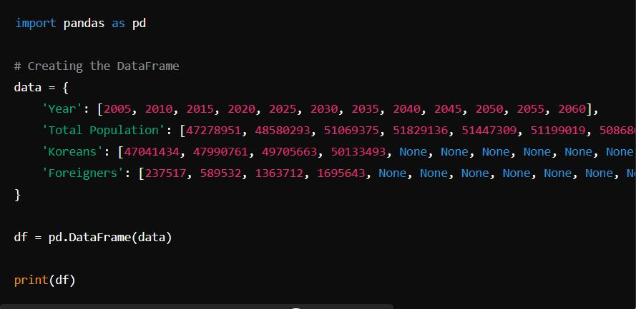
Create a Data Frame

Slide 7
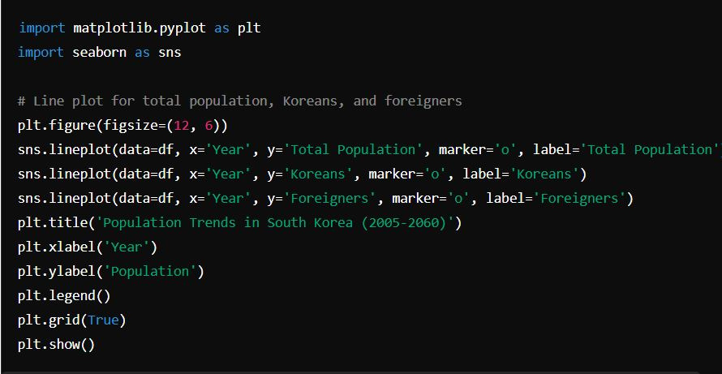
Plotting the Data

Slide 8

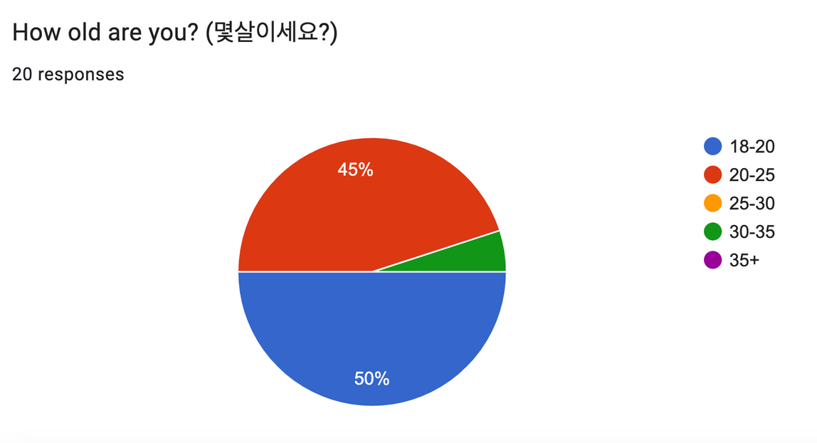
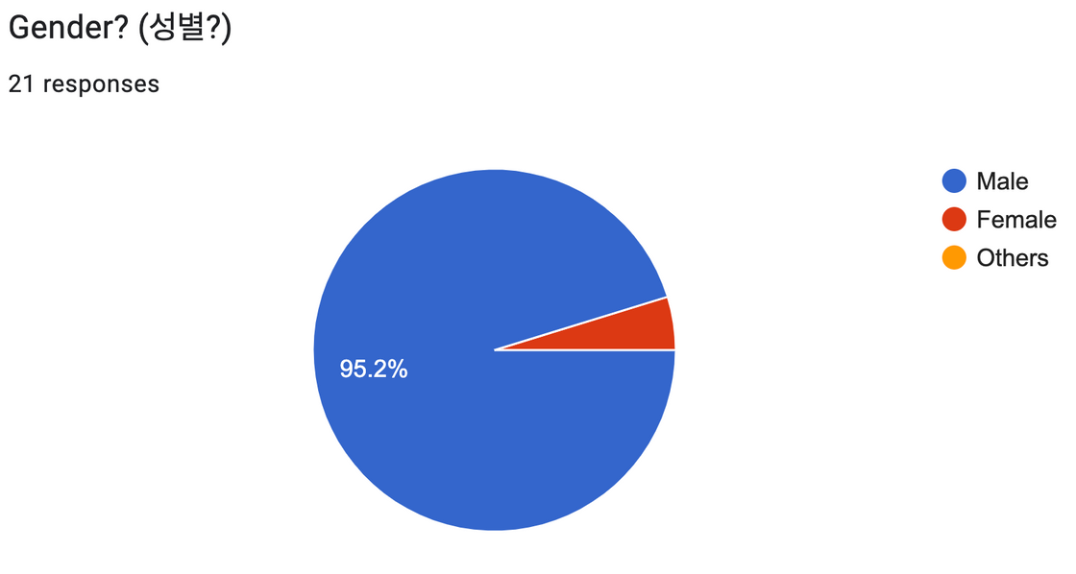
Google Form Survey results

Slide 9
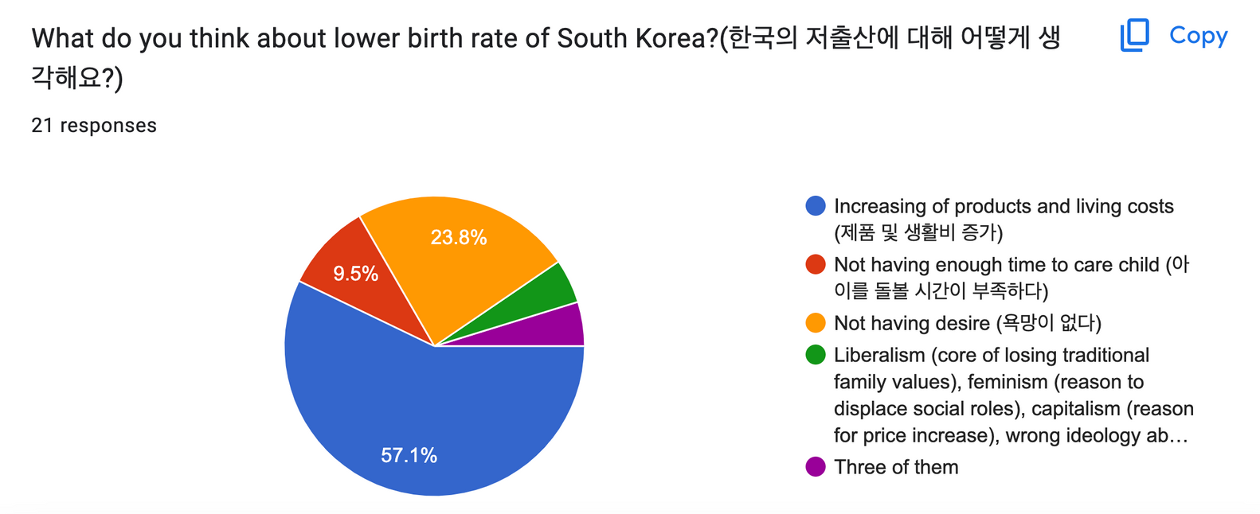
Google Form Survey results

Slide 10


Working with problems by government
As Korean citizens do not have enough time, the Korean government doing a “new project” that brings 100 caregivers from the Philippines. at the end of July.

Slide 11


Living together but not having baby...
Some Koreans do
not want to have a
baby even though
they are dating...
They afraid of caring and some portion of them want to care about their career. That’s why government worries about the future...

Slide 12


DATA ANALYSIS
The Decline of Birth Rates in South Korea

Slide 13




Data analysis Tools:
Python
Matplotlib
Numpy
Jupyter
Objective 01

Slide 14

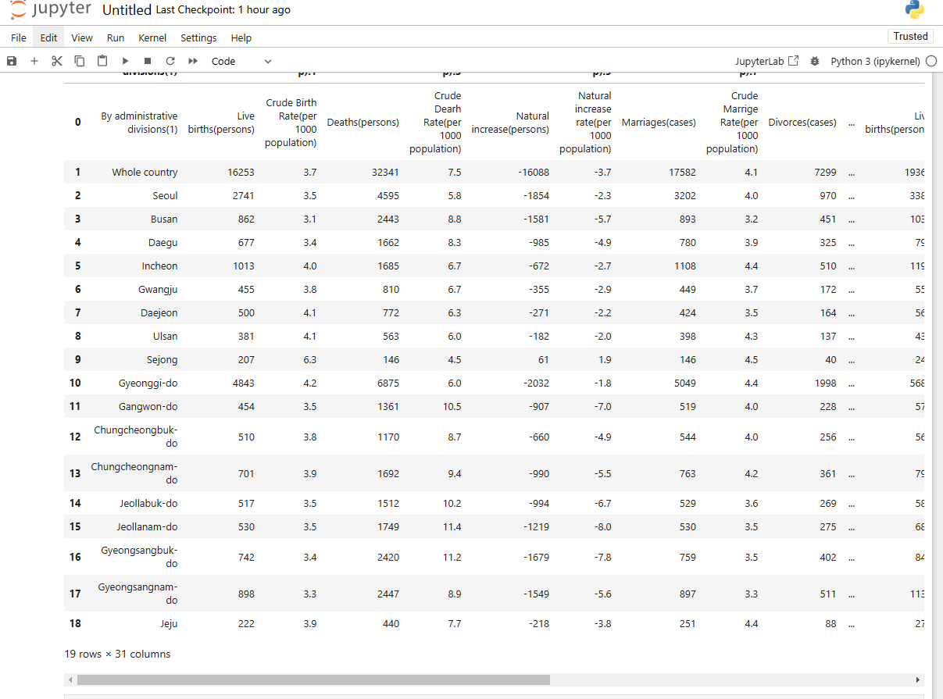
STATISTICS

Slide 15

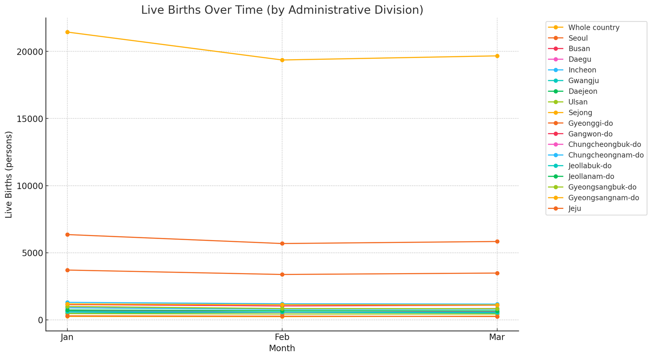
21440
Whole country
19660
6355
Gyeonggi-do
5840
297
Jeju
251

Slide 16
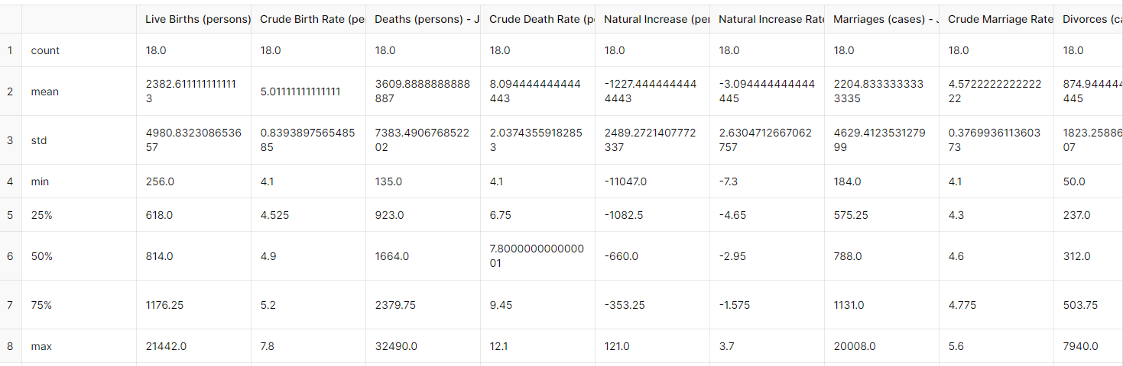
SUMMARY STATISTICS

Slide 17
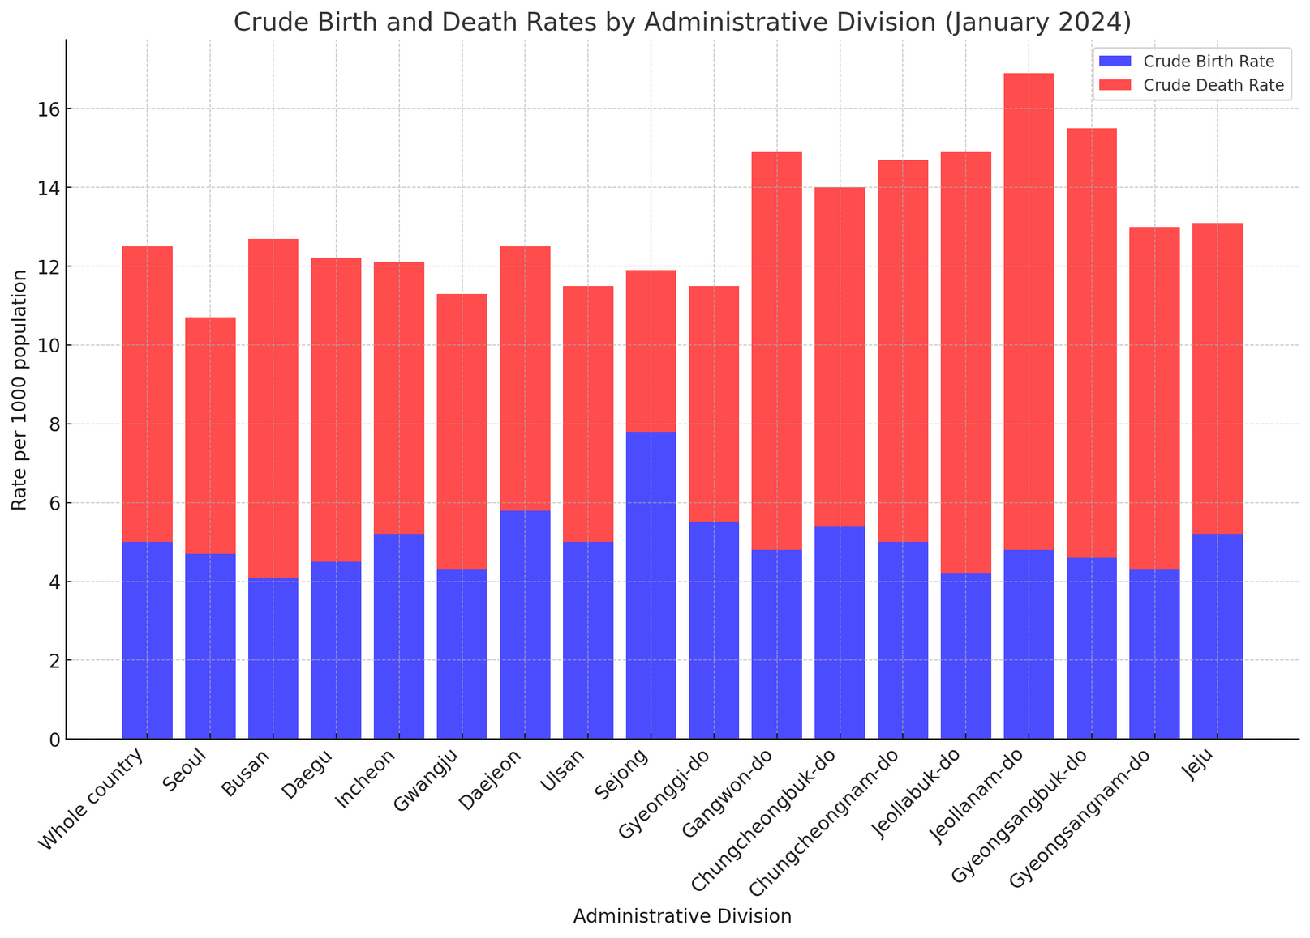

Slide 18
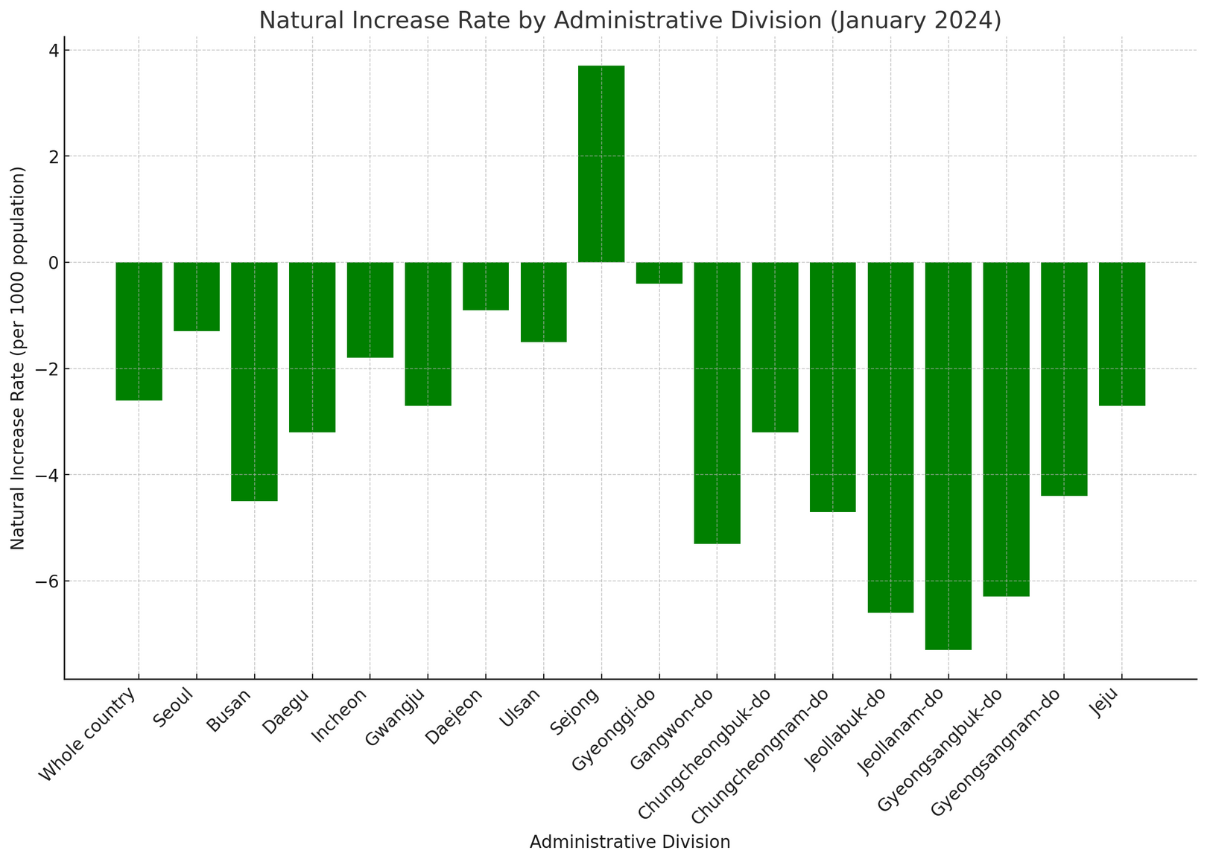

Slide 19
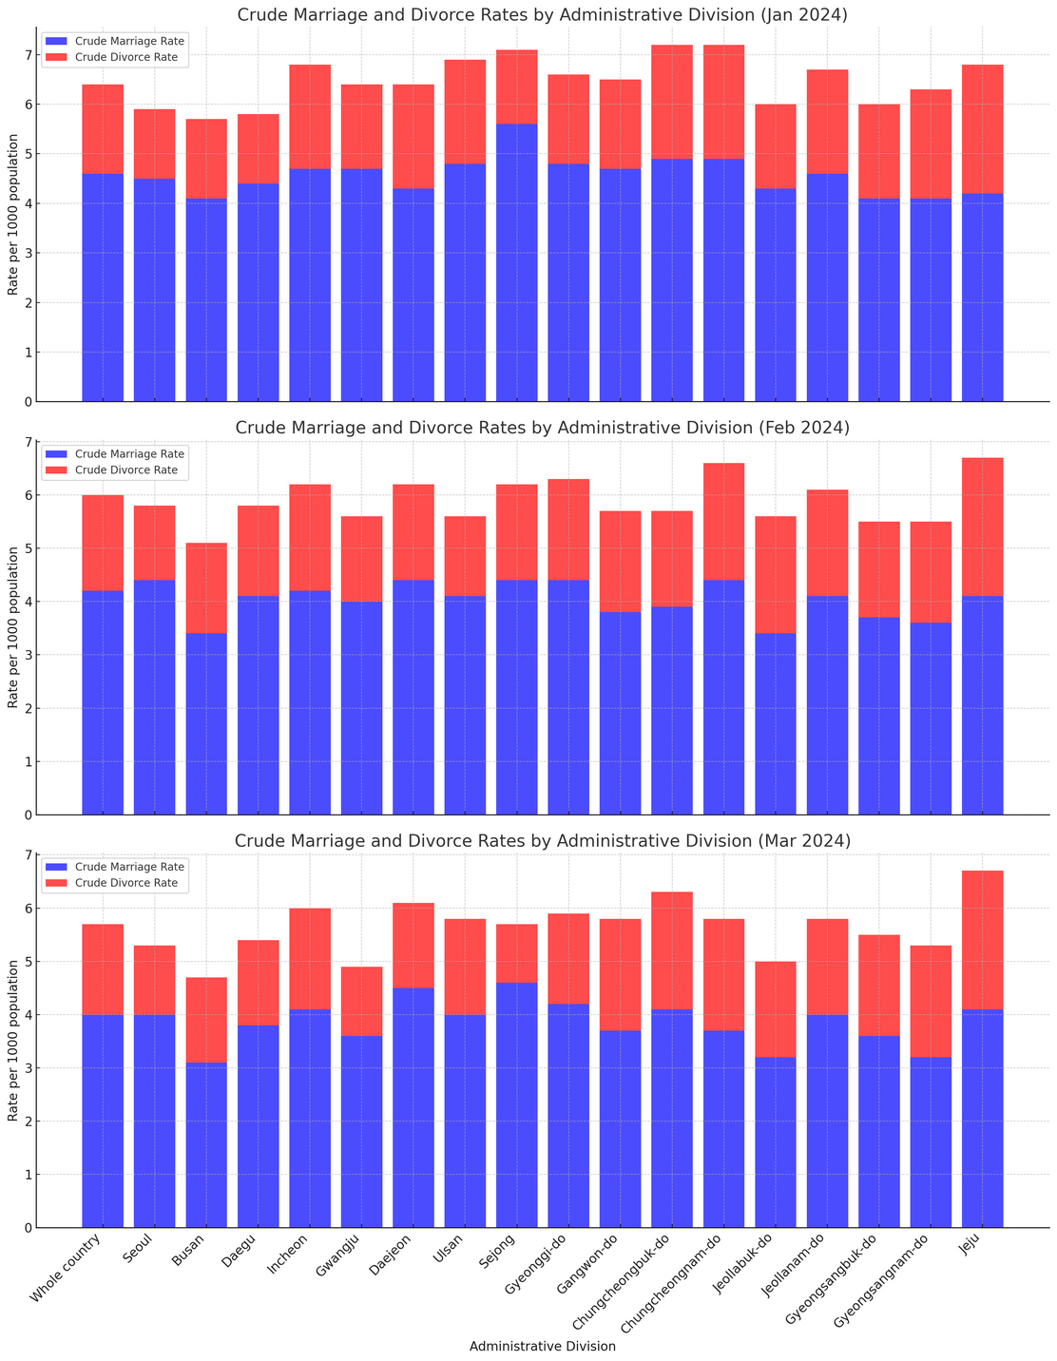

Slide 20

Policy Recommendations Based on key insights
Increasing living costs - Living Wage Policies: Encourage or mandate living wage policies that ensure employees are paid enough to cover their basic needs, including housing, food, and healthcare.
Increasing living costs - Affordable Housing and Education:
Ensure access to affordable, high-quality education and childcare services
Not having enough time for child-caring - Work-Life Balance:
Encourage companies to adopt practices that support working parents, such as on-site childcare and parental leave
Not having desire - Healthcare and Reproductive Services:
Provide comprehensive healthcare coverage for prenatal, postnatal, and pediatric care
Not Having desire - Cultural and Attitudinal Change:
Launch public awareness campaigns to promote positive attitudes towards family and parenthood

Slide 21

Team Dynamics
THANK YOU!
If you have any questions, feel free to ask!

